Slide 1
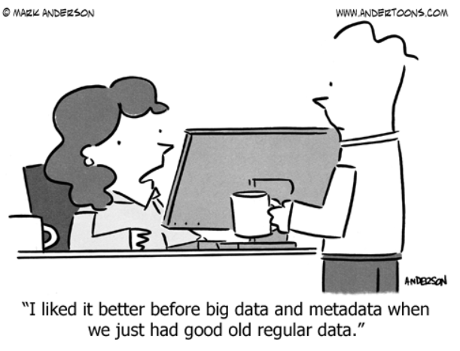
Cultivating a Culture of Digital Preservation Inside Academic Libraries and Out
Kelsey George,
Cataloging and Metadata Strategies Librarian
https://github.com/geokels
Image source: https://www.andertoons.com/data/cartoon/6826/liked-better-before-big-data-metadata-we-had-regular-data

Slide 2
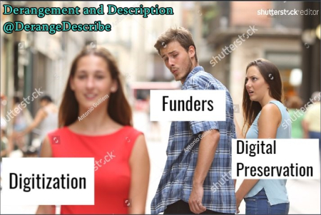
Image source: https://derangementanddescription.files.wordpress.com/2017/08/distracted_boyfriend_digitization.jpg?w=450&h=302

Slide 3
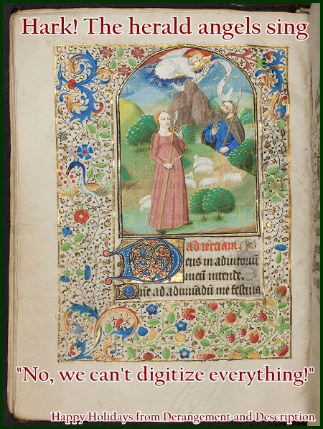
Digitization does not always equal access.
Digitization without a long term storage and preservation plan is a waste of time and resources.
Image credit: https://derangementanddescription.wordpress.com/2013/12/24/holiday-cards-for-archivists/

Slide 4
Donor requirements

Slide 5
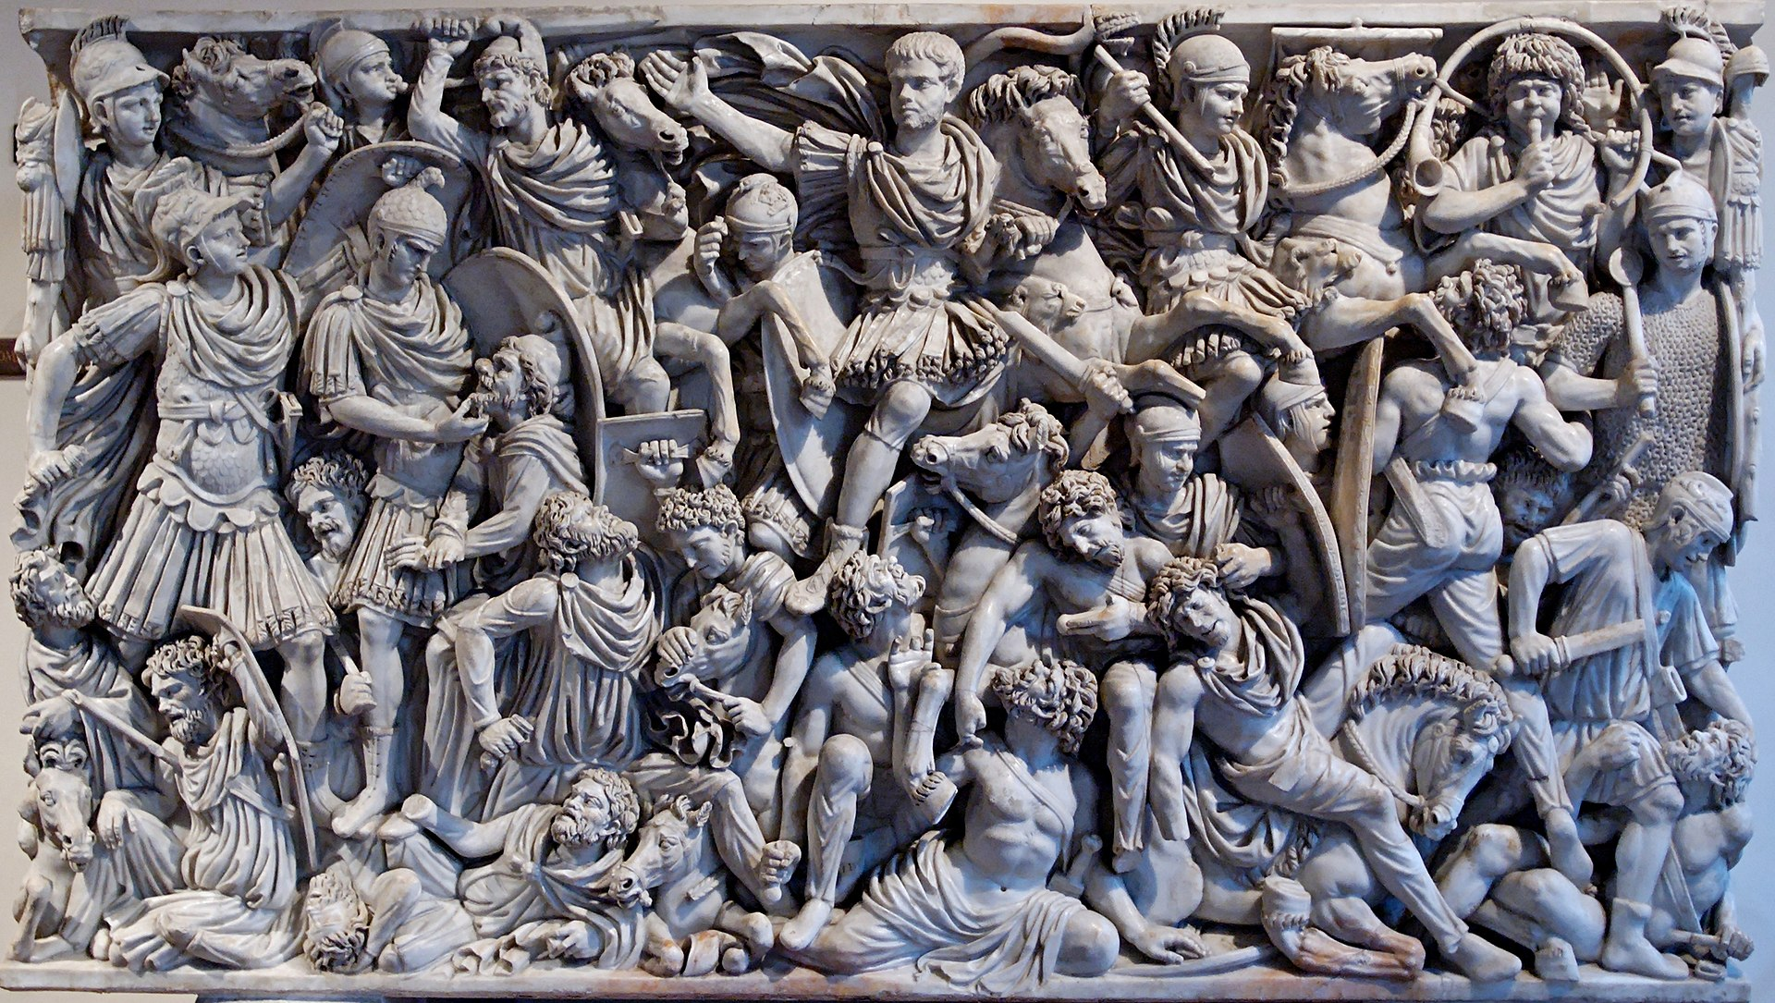
Battle for the Institutional Repository
Image title: Relief panel of the Great Ludovisi sarcophagus
Image source: https://en.wikipedia.org/wiki/Ludovisi_Battle_sarcophagus

Slide 6
What is your library’s digital preservation policy?
Focus on Born digital materials, digitized materials with no corresponding physical version, and
Create preservation metadata: What has been done to the material up until this point? How does it fit into your preservation policy? How will we convey preservation plans for the material in the record?
Access ,etadata” What restrictions and copyright issues are applicable to the material

Slide 7
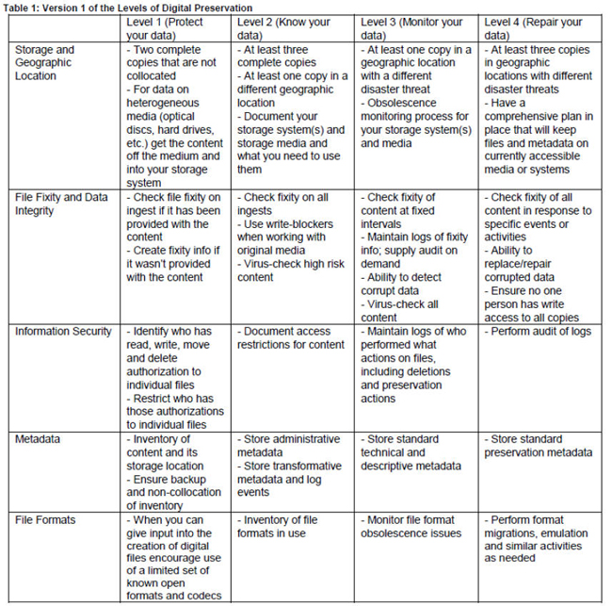
National Digital Stewardship Alliance

Slide 8
Links to GitHub Sites
Rendered site:
http://geokels.github.io/dig-preservation/
Source code:
https://github.com/geokels/dig-preservation

Slide 9
Primary obstacles to discoverability:
Broken URL’s
Lack of description
Lack of organization
Lack of accessibility

Slide 10
OAIS Reference Model
Use/Develop local documentation
It allows for consistency, reduces redundancy, provides context to work, creates historical record for future understanding

